Slide 1
Predicting The Next Recession
Stefan Kaehler

Slide 2
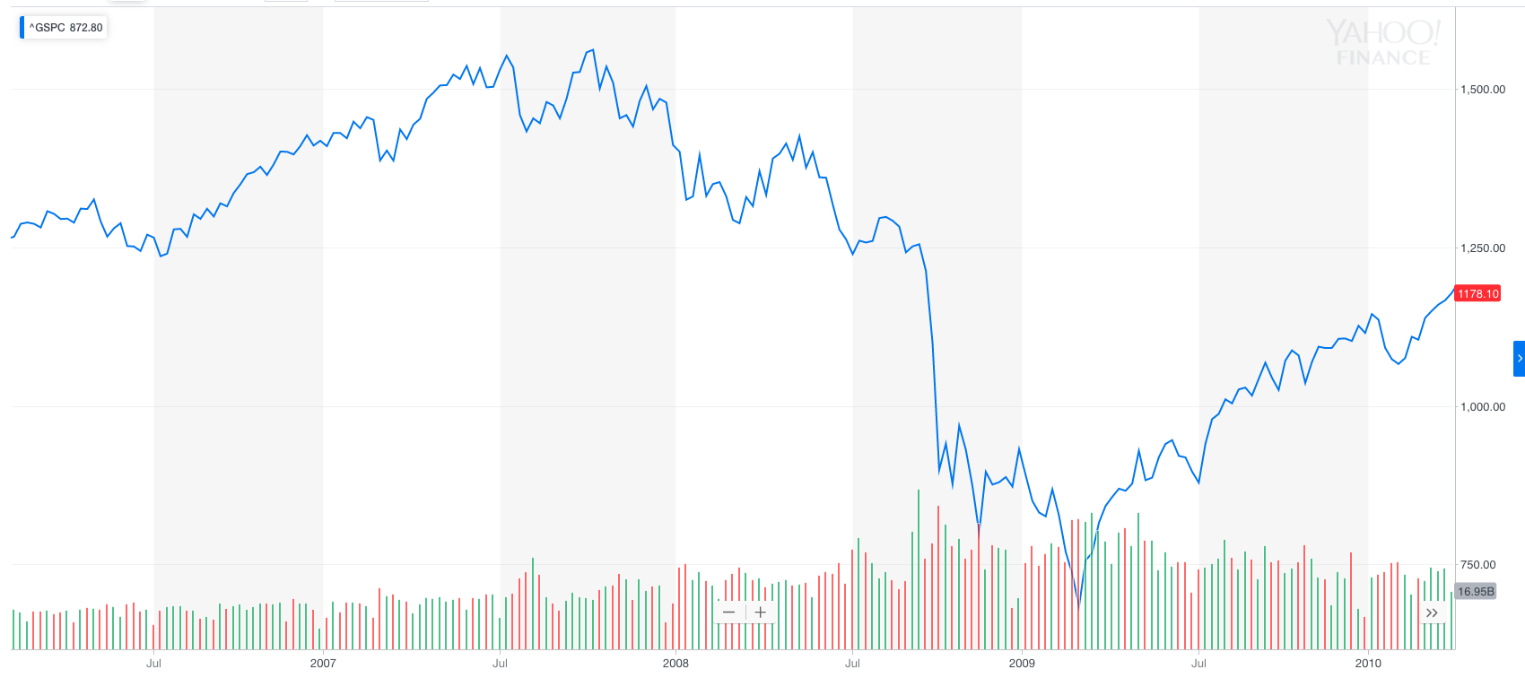
The Problem
Panic!

Slide 3
Methodology
Data
1960
March, 2019
Train
Test
November, 2004

Slide 4
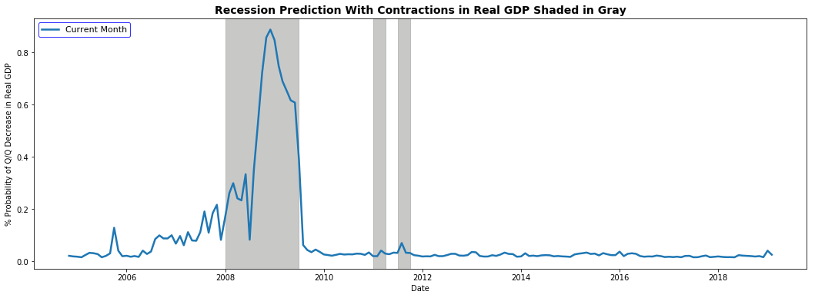
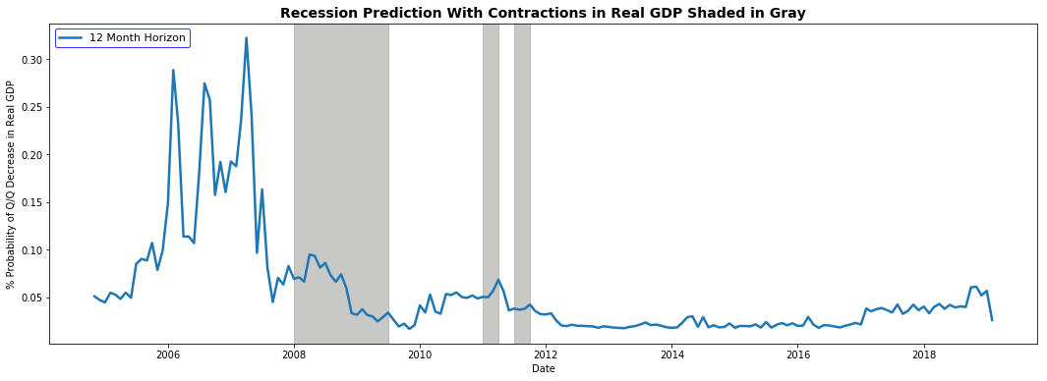
Models And Results
Logistic Regression | Metric | Log Loss | AUC
 | 0m | 0.317 | 0.796
 | 1m | 0.301 | 0.833
 | 3m | 0.3 | 0.839
 | 12m | 0.793 | 0.669
Random Forest | Metric | Log Loss | AUC
 | 0m | 0.357 | 0.836
 | 1m | 0.379 | 0.816
 | 3m | 0.403 | 0.87
 | 12m | 0.539 | 0.5961
Gradient Boosted | Metric | Log Loss | AUC
 | 0m | 0.266 | 0.878
 | 1m | 0.293 | 0.8425
 | 3m | 0.306 | 0.87248
 | 12m | 0.38 | 0.723

Slide 5
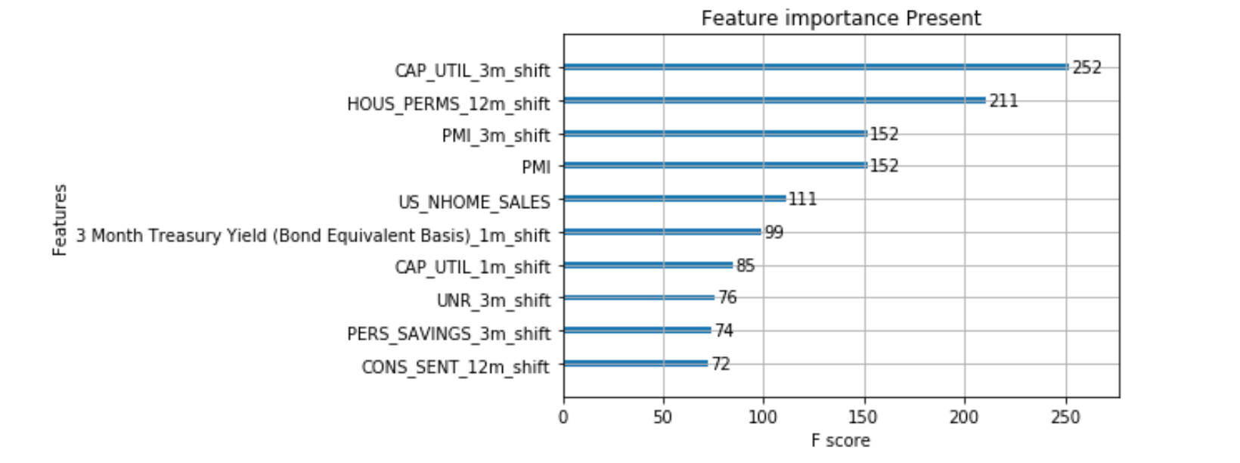
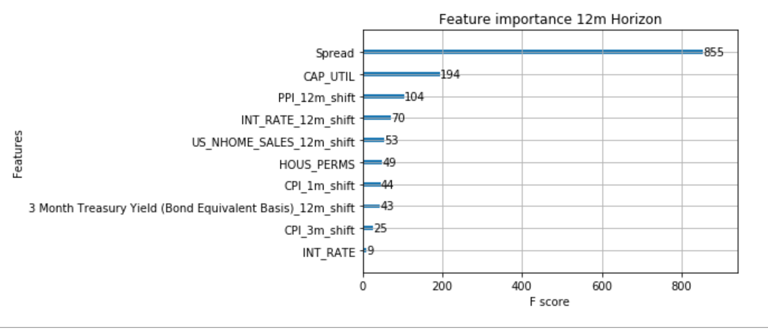
Feature Importance

Slide 6
Next Steps

Slide 7
Questions

